Slide 1

DEVELOPMENTAL PSYCHOLOGY Learning Session I
CHERRIE L. RAGUNTON

Slide 2

TOPIC OUTLINE
1. Introduction, Background & Issues
2. Research Methods 3. Theories of Human Development

Slide 3

INTRODUCTION, BACKGROUND AND ISSUES

Slide 4

Terms to Remember
DEVELOPMENT
refers to systematic changes in the individual that occur between conception and death.
01
CONTINUITY
ways in which we remain stable over time or continue to reflect our past.
02

Slide 5

DEVELOPMENTAL PSYCHOLOGY
Branch of psychology devoted to identifying and explaining the continuities and changes that individuals display over time.
It is multidimensional, multicontextual, multidisciplinal and multicultural.

Slide 6

DEVELOPMENTAL PSYCHOLOGY
Developmental sciences refers to the study of these phenomena and is a multidisciplinary enterprise.
Developmentalist refer to any scholar—regardless of discipline—who seeks to understand the developmental process.
Biologists, sociologists, anthropologists, educators, physicians, and even historians share an interest in developmental continuity and change, and have contributed in important ways to our understanding of both human and animal development.

Slide 7
WHY DO WE DEVELOP?
MATURATION
refers to the biological unfolding of the individual according to species-typical biological inheritance and an individual person’s biological inheritance.
01
LEARNING
is the process through which our experiences produce relatively permanent changes in our feelings, thoughts, and behaviours.
02
0

Slide 8

PATTERNS OF CHANGE
NORMATIVE DEVELOPMENT
developmental changes that characterize most or all members of a species; typical patterns of development.
IDEOGRAPHIC DEVELOPMENT
individual variations in the rate, extent, or direction of development.

Slide 9


ISSUES ON CHILD DEVELOPMENT
THE NATURE–NURTURE ISSUE
Inheritence or genetic factors and environmental influences. without it no development could occur!
01
STABILITY VERSUS CHANGE
Certain aspects of children’s development display consistency or changing across time.
02
CONTINUITY VERSUS DISCONTINUITY
Two ‘World Views’ which are called organismic and mechanistic.
03
Notes:
Organismic – Piaget - discontinuity
Mechanismic – behaviorist - continuity

Slide 10
MOTOR DEVELOPMENT
MOTOR MILESTONES
The basic motor skills acquired in infancy and early childhood, each new accomplishment brings with it an increasing degree of independence.
01
MATURATIONAL THEORIES
CEPHALOCAUDAL TREND - from head to foot along the length of the body.
PROXIMODISTAL TREND from the centre of the body outwards to more peripheral segments.
02
DYNAMIC SYSTEMS THEORY
All new motor development is the result of a dynamic and continual interaction of three major factors: (1) nervous system development; (2) the capabilities and biomechanics of the body; (3) environmental constraints and support
03

Slide 11
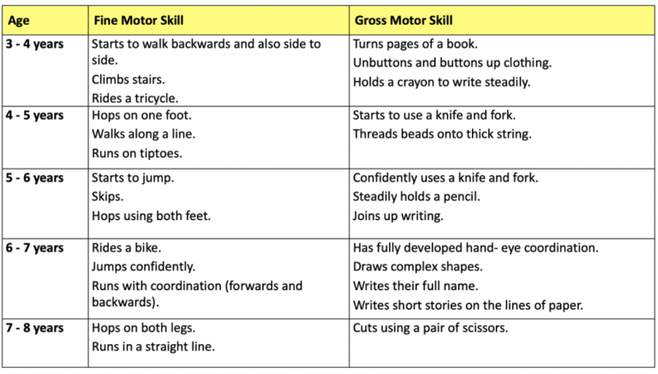

Slide 12

SCIENTIFIC STUDY OF DEVELOPMENT AND ITS ORIGINS

Slide 13

EARLY PERSPECTIVES ON CHILDHOOD
Hermann Ebbinghaus (1908), one of the founders of experimental psychology in the late 19th century: Psychology is a scientific discipline with “a long past but short history.”
With the advent of developmental psychology as an independent field of inquiry in the late 19th century, a new way of approaching these questions was established that relied more on empirical observation than philosophical speculation.

Slide 14

THOMAS HOBBES
Doctrine of original sin held that children are inherently selfish egoists who must be restrained by society.
Maintained that children must learn to re-channel their naturally selfish interests into socially acceptable outlets; in this sense, they are passive subjects to be molded by parents.

Slide 15


Doctrine of innate purity maintained that children are born with an intuitive sense of right and wrong that society often corrupts.
Children are actively involved in the shaping of their own intellects and personalities.
The child is not a “passive recipient of the tutor’s instruction” but a “busy, testing, motivated explorer. The active searching child, setting his own problems, stands in marked contrast to the receptive one . . . on whom society fixes its stamp”
JEAN JACQUES ROUSSEAU

Slide 16
JOHN LOCKE
Believed that the mind of an infant is a tabula rasa, or “blank slate,” and that children have no inborn tendencies.
01
In other words, children are neither inherently good nor inherently bad, and how they turn out depends entirely on their worldly experiences.
02
He believed that the child’s role is passive because the mind of an infant is a blank slate on which experience writes its lessons.
03

Slide 17

Children as Subjects of Study: Baby Biographies and Diaries
Charles Darwin, who made daily records of the early development of his son, curiosity about child development stemmed from his theory of evolution.
01
Clara and William Stern kept one of the first systematic diaries on the psychological development of their three children, Hilde, Günther, and Eva, born in 1900, 1902, and 1904, respectively, led to a book Die Kindersprache [Children’s talk], which became a classic in the language acquisition literature.
02
Jean Piaget, a famous Swiss psychologist, observed and recorded the development of his three children, Jacqueline, Lucienne, and Laurent, developed a more fine-grained methods for studying the development of logical thinking in children (Cognitive development).
03
Notes:
He believed that young, untrained infants share many characteristics with their nonhuman ancestors, and he advanced the (now discredited) idea that the development of the individual child retraces the entire evolutionary history of the species, thereby illustrating the “descent of man.”
So Darwin and many of his contemporaries viewed the baby biography as a means of answering questions about our evolutionary past.

Slide 18
METHODS OF DATA COLLECTION
OBSERVATIONAL METHOD
takes place in either a laboratory (laboratory observation) or a natural setting (naturalistic observation).
CASE STUDIES
extensive information about the life of an individual and then tests developmental hypotheses
SELF-REPORT
Structured interview
ETHNOGRAPHY
seeks to understand the unique values, traditions, and social processes of a culture or subculture
PSYCHO-PHYSIOLOGICAL METHODS
relationships between physiological processes and aspects of children’s physical, cognitive, social, or emotional behaviour/development.

Slide 19


THEORIES OF
HUMAN DEVELOPMENT

Slide 20
Freud’s PSYCHOSEXUAL theory states maturation of the sex instinct underlies stages of personality development, and that the manner in which parents manage children’s instinctual impulses determines the traits that children display.
Erikson’s PSYCHOSOCIAL is a revision of Freud’s theory, which emphasizes sociocultural (rather than sexual) determinants of development and posits a series of eight psychosocial conflicts that people must resolve successfully to display healthy psychological adjustments.
ECOLOGICAL SYSTEMS THEORY - BRONFENBRENNER’S model emphasizing that the developing person is embedded in a series of environmental systems that interact with one another and with the person to influence development.

Slide 21
ECOLOGICAL SYSTEMS THEORY
Child's development is affected by the different environments that they encounter during their life, including biological, interpersonal, societal, and cultural factors.
Describes the interactions between individuals and their environments and how these complex relationships affect development over time.
Many interconnected systems make up a person's environment that all interact to influence and shape how people grow and respond.
Stresses the interdependency and interaction between people and their environments.
Bronfenbrenner suggested that more nurturing and encouraging environments led to better developmental outcomes.

Slide 22
LEARNING THEORIES
WATSON believed that well-learned associations between external stimuli and observable responses (called habits) are the building blocks of human development.
SKINNER argued that both animals and humans repeat acts that lead to favourable outcomes and suppress those that lead to unfavourable outcomes.
Observational learning is simply learning that results from observing the behaviour of other people (called models).

Slide 23
PIAGET believed that children actively construct new understandings of the world based on their own experiences. They watch what goes on around them, experiment with objects they encounter; make connections or associations between events; and are puzzled when their current understandings (or schemes) fail to explain what they have experienced.
People continually rely on the complementary processes of ASSIMILATION and ACCOMMODATION to adapt to environments.
Initially, we attempt to understand new experiences or solve problems using our current cognitive schemes (assimilation). But we often find that our existing schemes are inadequate for these tasks, which then prompts us to revise them (accommodation) so that they provide a better “fit” with reality.
COGNITIVE DEVELOPMENTAL

Slide 24
COGNITIVE DEVELOPMENT
COGNITIVE ADAPTATIONS - cognitive awareness and understanding of the world.
ORGANISMIC WORLD VIEW - people are inherently active and continually interacting with the environment that shape their own development.
ASSIMILATION process through which children incorporate new experiences into their preexisting schemas.
ACCOMMODATION - process through which children adapt to new experiences by modifying their preexisting schemas.
SCHEMAS mental structures in the child’s thinking that provide representations and plans for enacting behaviours.

Slide 25
Vygotsky’s SOCIOCULTURAL perspective on development - children acquire their culture’s values, beliefs, and problem-solving strategies through collaborative dialogues with more knowledgeable members of society.
INFORMATION PROCESSING THEORY - perspective that views the human mind as a continuously developing symbol-manipulating system, similar to a computer, into which information flows, is operated on, and is converted into output (answers, inferences, or solutions to problems).
ETHOLOGY and EVOLUATIONARY - the study of the bioevolutionary basis of behaviour and development, with a focus on survival of the genes.

Slide 26

INFORMATION PROCESSING
View that cognitive processes are explained in terms of INPUTS AND OUTPUTS
Human mind is a system through which information flows.
STRATEGIES knowledge built up to solve particular problems.
CONSTRUCTIVISM - Piaget’s theoretical view that infants are not born with knowledge about the world, but instead gradually construct knowledge and the ability to represent reality mentally.

Slide 27
https://www.youtube.com/watch?v=8I2hrSRbmHE&list=WL&index=27&t=221s
https://www.youtube.com/watch?v=WjOowWxOXCg&list=WL&index=28&t=11s

